Slide 1

FLAG REGISTER OF 8085 and 8086

Slide 2
FLAG REGISTER OF 8085
A flag is a flip flop.
It indicates some condition produced by the execution of an instruction.
The flag register of 8085 microprocessor consists of 5 flags.
The flag register is connected to ALU.
When an operation is performed by ALU the result is transferred on data bus and status of result will be stored in flip flops.
The different flags and their positions in flag register are shown in following fig.

Slide 3
FLAG REGISTER OF 8085
Sign Flag (S) – After any operation if the MSB (7) of the result is 1, it indicates the number is negative and the sign flag becomes set, i.e., 1. If the MSB is 0, it indicates the number is positive and the sign flag becomes reset i.e., 0.
from 00H to 7F, sign flag is 0
from 80H to FF, sign flag is 1
1- MSB is 1 (negative)
0- MSB is 0 (positive)

Slide 4
FLAG REGISTER OF 8085
Zero Flag (Z) – After any arithmetical or logical operation if the result is 0 (00)H, the zero flag becomes set i.e. 1, otherwise it becomes reset i.e. 0.
For 00H zero flag is 1.
from 01H to FFH zero flag is 0
1- zero result
0- non-zero result

Slide 5
FLAG REGISTER OF 8085
Auxiliary Carry Flag (AC)
This flag is used in BCD number system (0-9).
If after any arithmetic or logical operation (3) generates any carry and passes on to (4) this flag becomes set, i.e., 1, otherwise it becomes reset, i.e., 0.
This is the only flag register which is not accessible by the programmer
1-carry out from bit 3 on addition or borrow into bit 3 on subtraction.
0-otherwise

Slide 6
FLAG REGISTER OF 8085
Parity Flag (P)
If after any arithmetic or logical operation the result has even parity, an even number of 1 bits, the parity register becomes set, i.e., 1.
Otherwise, it becomes reset, i.e., 0.
1-accumulator has even number of 1 bits 0-accumulator has odd parity

Slide 7
FLAG REGISTER OF 8085
Carry Flag (CY)
Carry is generated when performing n bit operations and the result is more than n bits, then this flag becomes set, i.e., 1, otherwise it becomes reset, i.e., 0.
During subtraction (A-B), if A>B it becomes reset and if (A<B) it becomes set. Carry flag is also called borrow flag.
1-carry out from MSB bit on addition or borrow into MSB bit on subtraction 0-no carry out or borrow into MSB bit

Slide 8
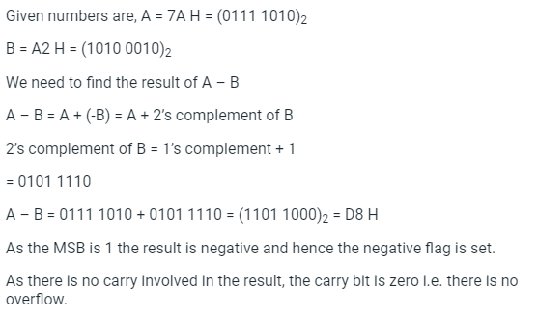
EXAMPLE 1
Q The ALU of a microprocessor performs operations of 8-bit two’s compliment operands. What happens when the operation 7AH-2H is performed?

Slide 9
Example 2
How many flip-flops are there in a flag register of 8085 microprocessor? a) 4 b) 5 c) 7 d) 10
Which of the following flag condition is used for BCD arithmetic operations in microprocessor? a) Sign flag b) Auxiliary carry flag c) Parity flag d) Zero flag

Slide 10
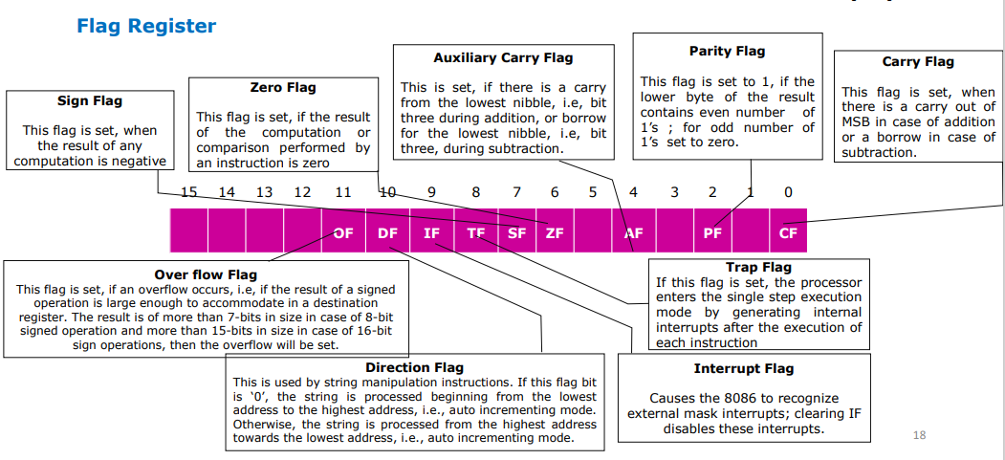
FLAG REGISTER 0F 8086

Slide 11
Example
Add the following 16-bit numbers to determine the status of flag in 8086.
FAED + DEFB
Direction flag is used with
String instructions
Stack instructions
Arithmetic instructions
Branching instructions

